Slide 1
BigData for Bing Ads

Slide 2
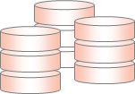


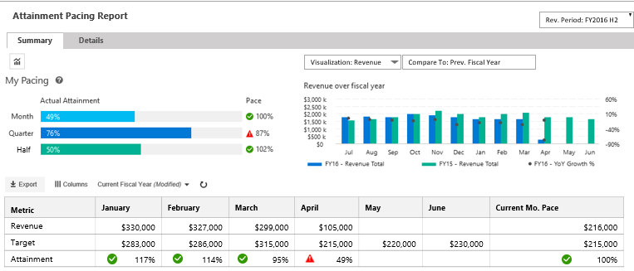
Architecture
Architecture Overview of UCM-B
SOURCES/
PRODUCERS
COLLECTION / STAGING
MERGE/CLEANSING
/ENRICHMENT
TRANSFORMATION
BUSINESS RULES
CACHED VIEWS
PIVOTS
PRESENTATION/
ACTIONS
Azure Data Factory
[ Data Ingestion, Layers Orchestration and Data Auditing]
Staging Area Subscriber
[Accounts, Customer, Exchange rates, etc.]
ETL
Adhoc Engines
Azure Data Lake
ADW
MDX CUBE
KPIs, Metrics Hierarchy
ADLS STAGING
WARM
Business
Users
Confirmed Dimensions
Date, Product, etc.
Optimized for 2 year
SQL Sources
PAAS: UCM
On-Premise : MDB
SQL Server Gateway
USQL
ADLS STAGING
WARM
Dimensions
Customer, Account, ..
Delta Merges
Business Reporting Views
UCM-B Business Reporting Web site
Analysis Services
RvR Cube
PowerShell Upload
Facts
Revenue, Attainments,
Relational DW
Account Teams
ADLS as TSV
[Archived daily]
Maps
Account-CU, Timeline
Cached Data
WWIC Flat Files
Structured Files
[KPIBillingCube]
WWIC Views
COLD
USQL
HYBRID PROCESSING
WWIC Teams
HYBRID STORAGE [BLOB/DB]
NORMALIZE
METRICS ENGINE
REPORTING and UIX

Slide 3



.
Design & Engineering
Key Learnings from Engineering
Data Volume
How do we ensure the combined volume of UCM-B data can be managed effectively in a Centralized Data Warehouse ?
Considering the combined data volume from UCM-B platform and the future growth, we will apply the concepts of HOT and COLD path for active data processing and historical data storage.
60% of the total data volume is older than a year. This will be managed as Flat files in Azure Storage with an option to load on-demand using Polybase/USQL
This effectively makes the ACTIVE Data warehouse efficient and highly performing.
Security
How do we ensure the data security of UCM-B Centralized Data Warehouse ?
Data Masking, Encryption and Transparent Data Security will ensure the data security for HBI data
Down stream requirements where row-level security is required shall be replicated as satellite databases with Azure SQL and data managed
All access shall be centrally managed with AAD (Azure Active Directory) Service Accounts
Geo-Availability
How do we ensure the high-volume availability requirement for all the end users?
ADW can be replicated onto multiple servers within a few minutes based on the load patterns of down streams
Dynamic scalability can be provided based on Geo-proximity for faster data access
Orchestration
& Schedules
How do we ensure the combined data sources will not impact the overall processing time?
With increased number of data sources, multiple data pulls will be managed by Azure Data Factories in parallel
Fast-Data concepts ensure data is cleansed within the pipelines and is available faster thereby avoiding multiple data hops.
Down-streams
How do we ensure the connectivity of down-streams?
ADW works similar to SQL Server and works the same with a connection string and access control
It is similar to a Server upgrade and most of the down streams will not be impacted

Slide 4
Data Engineering for MARS India

Slide 5
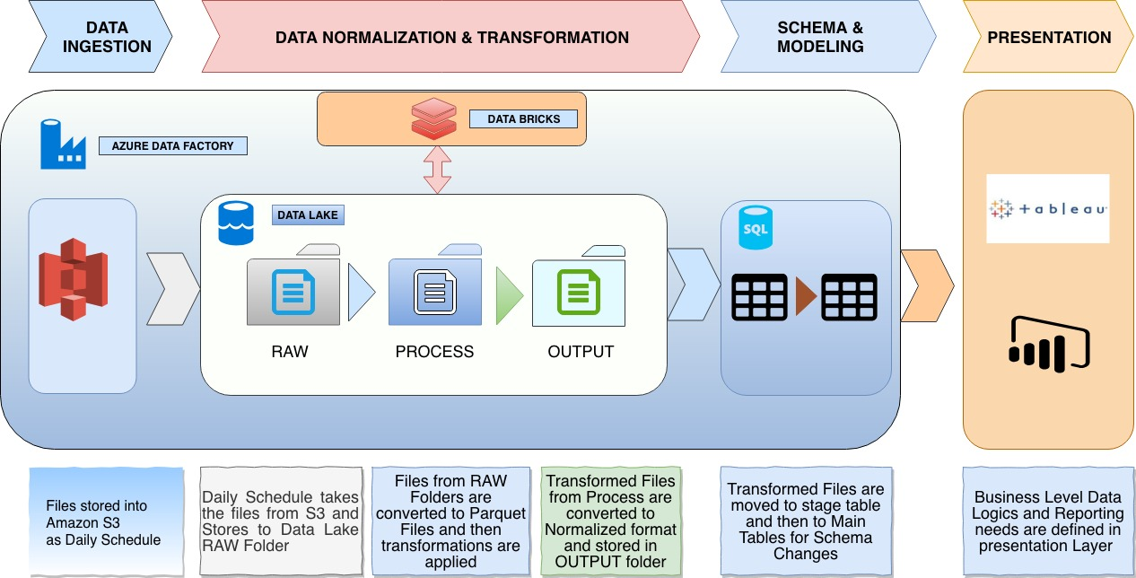

Slide 6
Data Quality Automation

Slide 7
What are the challenges in data quality on Azure Big Data systems..
Data Quality
Vision
Data volume and velocity is at a high pace and non-relational too..
Manual validation and QC is beyond the scope ..
Lack of traditional policy checks like PKs, FKs, etc.
Putting together ACID rules is hard
Data counts needs to be continuously checked..
Need to know the freshness of billions of data..
Need to ensure data coverage of transition of millions records across storage layers
Data moves between relational and non-relational stores and ensuring consistency
1
Develop a generic data quality engine that can run on Azure and capable of verifying data against multiple data sources including Azure DBs, Azure Data Lake, Warehouses and MDX Cubes
2
3
4
Distributed business rules..
Data is processed at multiple stages and faults can occur anywhere..
Goals
Support multiple connectors
Fully automated testing
Dynamic scalability
Centralized Governance
Team & Reports friendly
5
Lack of Visual Studio validation tools
No ready available tools like Performance tester etc.
6

Slide 8
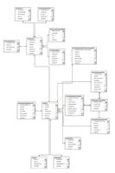
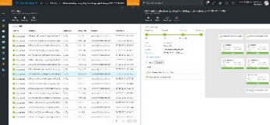
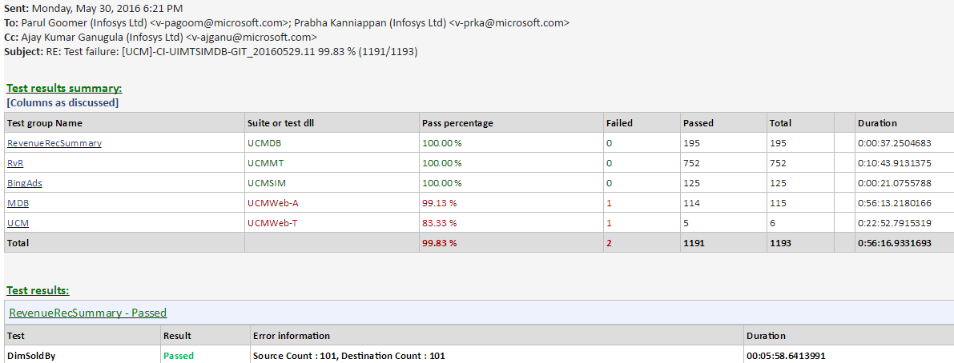
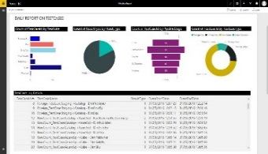
Data flow diagram of the Data Quality engine
Data Quality
Data Quality
Authoring
Execution
Data Quality Engine enabled to validate 18 rules likes value checks, primary key checks, row count checks etc.
Comprehensive work flow for authoring, execution and monitoring for Azure Data warehouse and Azure Data Lake
ATC (Automated Test Controller) with daily mails to all the stake holders
Live Power BI dashboards for analyzing the quality of the system
Test Case Authoring Engine
Test Case Scheduling
Test Case Flags
PowerShell Engine
Execute on
ADL
ADW
DB
Files
Alerting
Monitoring
Emails with Logs
Action on Bugs
Missing test cases
Live Visualization
View Logs
View Exceptions

Slide 9
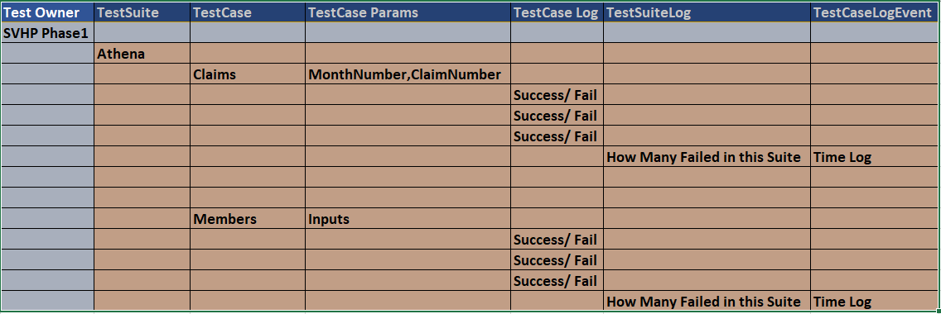
Phase 2 - Validation Storage
Notes:
Will Require SVHP Support for Test Cases on what basis they do .

Slide 10
Data Quality
What are the rules validated in UCM-B
SOURCES/
PRODUCERS
STAGING
ADLS
CLEANSING
/ENRICHMENT
TRANSFORMATION
ADLA / USQL
RDBMS
ADW
CACHED
VIEWS
PIVOTS
Cube
PRESENTATION/
ACTIONS
Data availability
Count Check
PrimaryKey Check
BoB & Quota Checks
Data Length Check
Data archiving
Foreign Key Check
Attainment Checks
Client Unit
Segment
New Business
Channel Partner
Missing Quota
Data Type Check
Dev/Prod Checks
Other Cube Check:
ARC
RvR
KPI Billing
Duplicate Row Check
All the rules above are automated using a custom PowerShell engine
10

Slide 11
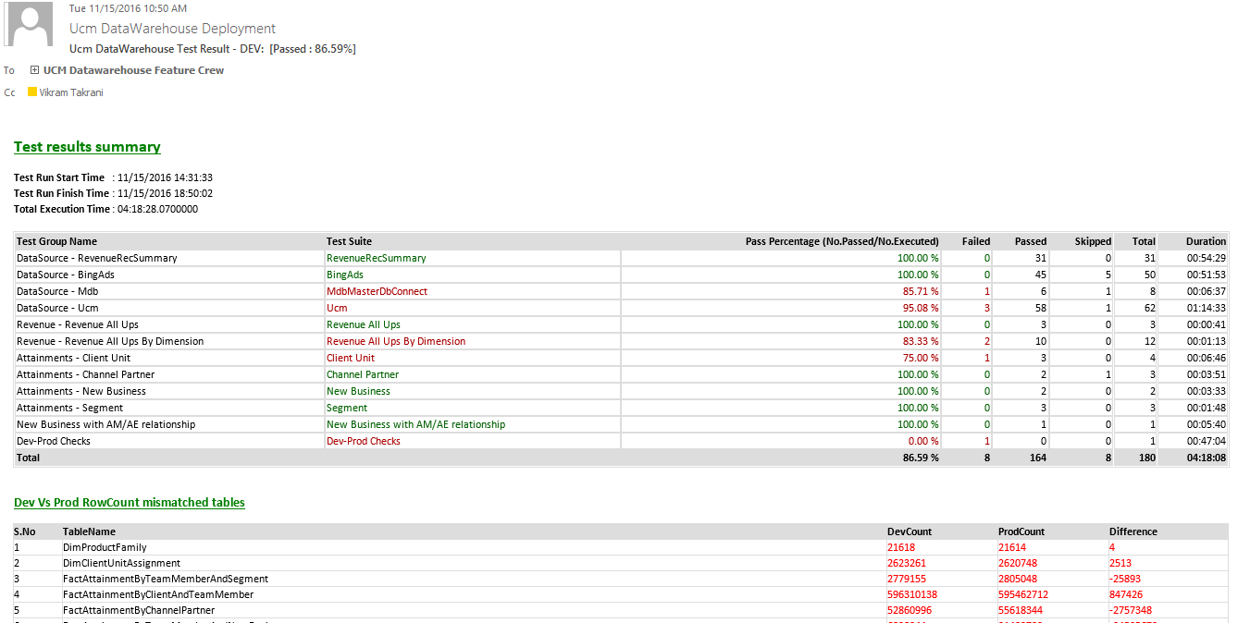
Daily Validation status in email
Program Highlights

Slide 12
NFR view in UCM-B
SOURCES/
PRODUCERS
COLLECTION / STAGING
MERGE/CLEANSING
/ENRICHMENT
TRANSFORMATION
BUSINESS RULES
CACHED VIEWS
PIVOTS
PRESENTATION/
ACTIONS
Azure Data Factory
[ Data Ingestion, Layers Orchestration and Data Auditing]
Staging Area Subscriber
[Accounts, Customer, Exchange rates, etc.]
Fast ETL
Adhoc Engines
Azure Data Lake
ADW
MDX CUBE
KPIs, Metrics Hierarchy
ADLS STAGING
HOT
Business
Users
Confirmed Dimensions
Date, Product, etc.
Optimized for 2 year
SQL Sources
PAAS/On-Prem
[MDB, UCM, etc.]
SQL Server Gateway
USQL
ADLS STAGING
Dimensions
Customer, Account, ..
Delta Merges
WARM/COLD
Analysis Services
RvR Cube
PowerShell Upload
Facts
Revenue, Attainments,
Relational DW
Business Reporting Views
UCM-B Business Reporting Web site
ADLS as TSV
[Archived daily]
Maps
Account-CU, Timeline
Cached Data
Account Teams
Structured Files
[KPIBillingCube]
WWIC Views
COLD
USQL
HYBRID PROCESSING
HYBRID STORAGE [BLOB/DB]
NORMALIZE
METRICS ENGINE
REPORTING and UIX
AZURE CAPABILITIES
ENCRYPTION
SECURITY
DATA QUALITY
TELEMETRY
LOGGING
ERROR HANDLING
WORK FLOWS
GOVERNANCE
META-DATA
LINEAGE
AUDITS
REPORTS
ALERTS
ROLES
RULES

Slide 13

What is the criteria in choosing a ‘high-performance’ data platform for UCM-B
Design & Engineering
 | Azure DW | Azure Data Lake | COSMOS
 | SQL Azure DWH – PAAS solution with elastic scale for performance/scalability Central DWH contains granular data | Azure Data Lake store/analytics aligning to Cortana Analytics Suite | COSMOS Data store for processing/storing data
Volume | Traditional central EDW is known to work for the projected volume but may not be optimal with data size of 1-2 TB | Physically partitioned data and hence can accommodate higher volumes. | Designed for high volume data warehouses.
Load Performance | Load performance can be matched with increased DTUs but comes with cost | Parallel processing with MPP results in better performance and performance can be boosted with increased DTUs | Parallel processing with Map-Reduce results in better performance.
Data Access | Access is easier. Query performance can be an issue. | Easier and data access through USQL other standard open source. | Data access restricted through Scope scripts
Scalability | 4-5 TB SQL Azure node has to be partitioned to multiple DBs | Can be scalable by adding more logical partitions for new data source/growth | Good Scalability
Strategic Alignment | Aligns with Cortana Analytics suite recommendation | Aligns with Cortana Analytics suite recommendation and strategy to migrated from COSMOS to ADL | With latest development with strategy to move to Azure Data Lake
Complexity | Simplest of the 3 approaches | Development and Complexity higher for configurable calculation engine | Development and Complexity higher for configurable calculation engine
Cost | Cost assuming a 4-5 TB size will be around $7000/TB | Medium considering Azure Data Lake instance and worker role process | Medium - High
Security Compliance | Storing PII/HBI data through encryption/ decryption modules | ADL support storing PII/HBI data at rest through OOB functionality | PI information in a common environment will not comply and has to do custom coding
Good Fit
Workaround Needed
Not Good Fit

Slide 14

Data Ingestion and Orchestration needs…
We had the challenge to find a right solution that can
Ingest millions of records per day
Orchestrate with On-Premise sources like SQL Servers and Cosmos, as well as cloud sources like SQL Azure databases
Have inbuilt capability to process data ‘as-is’ including files, databases, services etc.
We have chosen Azure Data Factories for ingestion and orchestration..

Slide 15
Services Industry vertical-wise
manufacturing
FMCG
bfsi
BFSI
Non profit (ngos)
Govt related

Slide 16

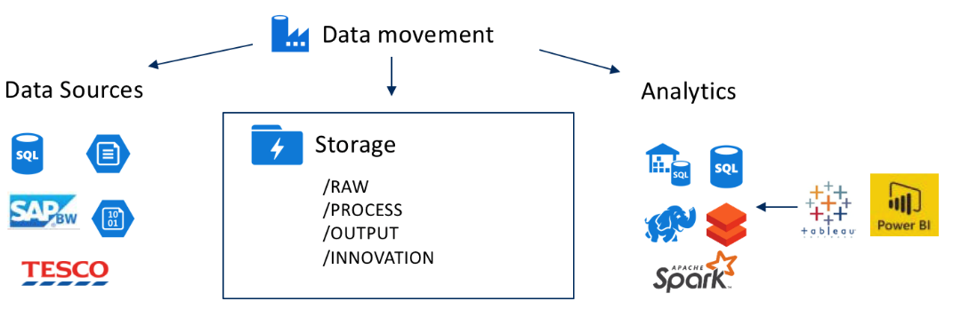
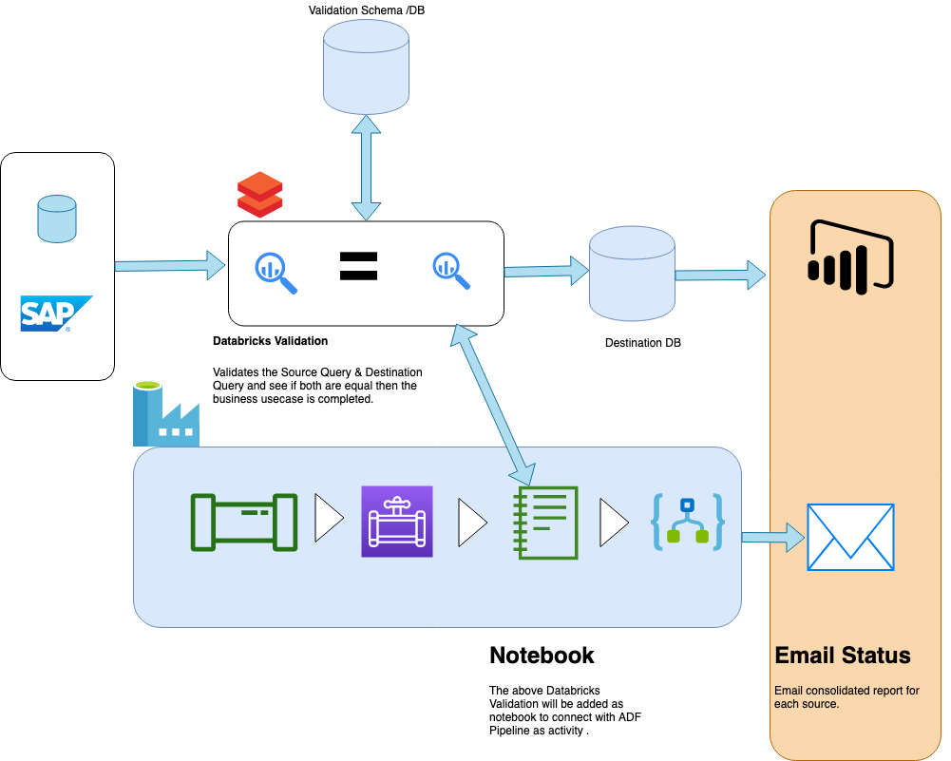
Architectural blueprint
Insert some brief data, analysis and information about the title main here.
manufacturing
Problem Statement
Ability to analyze data coming from SAP & Manufacturing Distributors related data for Loan & Repayment of Spare Parts.
System should provide clean and estimated view of how the business can leverage the data coming from multiple systems.
Solution approach
Data is getting inserted from multiple sources and from multiple formatted files. The approach is to get the data as is and storage them into multiple zones in Data Lake .
Leverage the importance of Azure Data Factory for scheduled data loads on SCD2. Completely Automate the Data Travel from source to destination DB.
System should be capable of handling more than 15 sources .
Business impact
Completely Automated Data Movement and Analysis . Build Easily usable Power BI reports by creating data marts . Ability to predict if the distributors would pay the monthly payment before time. Increased the approach of investment

Slide 17
Have 360 degree view of Sales , Revenue Management of Bing Ads . Ability to view the data by mapping the account level managers to revenue generation . All the sources to be integrated are in silos and needs to be integrated .
Volume of data is varying from 500GB - 1TB every day. This data needs to be tapered to get consolidated reports to the business analysts.
Business impact
Insert some brief data, analysis and information about the title main here.
Retail
Problem Statement
Ability to have complete overview on Bing Ads life cycle . Sales Management Hierarchy and region specific view of data . Reduced manual effort to update the excel sheet on a daily basis for the reporting needs.
Solution approach
1. Azure Data Factory for ingesting data from multiple sources to Data Lake and then to DW.
2. Azure Data Lake for storing the raw and transformed data and define the dimensions and facts using Lake analytics .
3. SQL Data Warehouse for storing 16 months of data and creating views on top of it .
4. Azure Analysis Services for creating cached views .
5. Power BI for Representing the data as per User Needs.

Slide 18
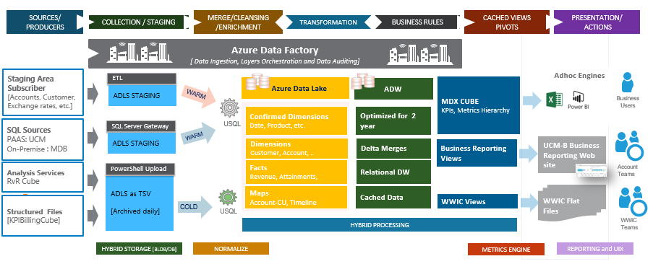
Architectural Implementation

Slide 19
Approach for Image Classification and Tagging

Slide 20
Architectural blueprint
BFSI
The main concern for the banks is to provide the better prediction model which can predict the defaulters in a better way.
We considered a solution to get the images of the business outlet location
Gather images related to
Inside of Business
Outside View
Street View
Electronic Goods
Type of Business.
License Agreement.
This Data is fed into the existing model as a tag for the above features. This feed is used for predicting better analytics for Business .
Problem Statement
Providing Loans to customers who have small and medium scale shops and business is difficult but they wanted to go with an approach which can at least help them identify better prediction rate.
Solution approach
Below are the steps involved in implementing the solution .
Get the image files from the store location and upload into the system through web portal.
Apply Custom Vision and generate tags for the images .
Pass the Images into the system as categories and send to SQL DB.
Apply Machine Learning Model on top of the SQL DB using AML Services and generate insights .
Business impact
Now the bank is ready to deploy the solution to have better acceptance of small scale and medium defaulter . We are able to implement solution which improved the accuracy from 81 to 89% in accuracy.

Slide 21
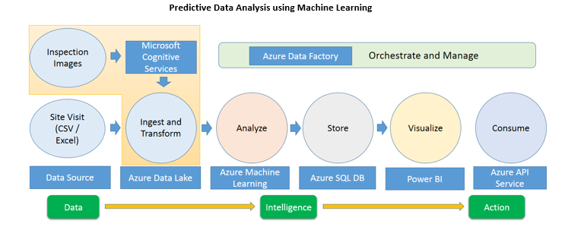

Slide 22
Services Industry vertical-wise
FMCG
bfsi
manufacturing
BFSI
Non profit (ngos)
Govt related

Slide 23

Architectural blueprint
fmcg
Purchase & Inventory Management takes a tedious process of reading each file from the system and apply the periodic and validation logic . Multiple departments receives data through email and the purchase data comes through SAP .
The solution is designed in a robust way that all the scalability and modelling will be designed just by users uploading the files into a storage in Azure and the whole process gets initiated through triggers.
Databricks is leveraged by Mars globally to have a centralized medium for transformation and building models. We have leveraged data lake as a storage medium for the data globally across MARS. This data points are mounted onto Azure Data bricks. Where the data files are first converted to Parquet formats .
Data from sensors comes through kafta and leverages Data bricks to use continuously streaming and delta storage into the tables. This data is aggregated and stored into SQL DB for reporting to Sales & Inventory Teams.
Problem Statement
Reduce the Manual daily effort to consolidate the data from Sales , Inventory & Purchases Departments . To have centralized governance of the data . Centralized Governance of all the data sources .
Solution approach
Design a solution which can scale up to handle multiple sources and centralized .
1. Get the data from SAP and Amazon S3 as flat files .
2. Apply the transformations using Azure Data Bricks
3. Sent the data into SQL DB using Data Factory .
4. Expose the data into Presentation Layer for end users .
5. Define the archival and aggregation process using data bricks and data factory.
6. Data coming from sensors goes through Databricks Delta for storage and aggregation .
Business impact
The greatest impact is to have users manually upload the file into the storage location and the system can automatically validate and push the data by doing the transformation into a report.
It reduced 40% of the Purchase & Inventory department workloads which used to be manually reviewing the inventory and purchase reports and validating on daily basis.

Slide 24
Architectural Implementation

Slide 25
Services Industry vertical-wise
FMCG
bfsi
manufacturing
BFSI
Non profit (NGOs)
Govt related

Slide 26

Solution approach continued…
Liveliness Detection
This is the Final Level of Validation where in User Gestures are validated and the Liveliness of the photo is tested.
GUIS (Gesture Understanding Intelligent System): We Propose to Build a Platform to Capture all the possible Gestures that Bank Customers can use for the liveliness detection like – Eye Blinking, Raising of Hand, Moving Head Left or Right etc. This platform allows IT admin to Mask / Unmask the Gestures from time-to-time. If admin things Gestures are times out and there is possibility to break the system using recorded gestures, he can mask those gestures and create a new set of Gestures.
While Reiteration or Verification, users will be randomized with Gestures created in this Platform and the liveliness is validated.
GUIS internally uses the right Cognitive API for the right gesture – Computer Vision, Customer Vision Classification, Custom Vision Object Detection.
Active Learning Module
This is a very crucial module for any ML problem that we are trying to solve – Vision, Audio or NLP. Precision & Recall for ML problems progressively gets better. To achieve the same, we need to have proper instrumentation system in place that helps in fine-tuning the algorithm results
We need to fine-tune results of “Client Side Image Validation Engine (Gate 1)” and “Image Depth Analytics Engine (Gate 2)”. For this purpose, we have to store all the failed Images of these two engines in a temporary storage ( Blob, Cosmos DB) with a retention period of 2-4 weeks. Active Learning Modules reads all the images from this storage and helps to enrich algorithms by adding more data-sets
BFSI
Problem Statement
Kotak Bank is embarking on a key organizational initiative aimed at introducing “Facial Recognition” as the 3 Factor Authentication to all customers. It is the most innovate and “first of its kind “in India’s Banking Ecosystem. By December 2019, 19 million banking consumers of KMBL will be using Facial Recognition based authentication for many of the critical use-cases that needs 3 factor authentication
Solution approach
JumpStartNinja is involved in developing the following building blocks that enables KMBL consumers register their Face as a biometric measure for authentication
Image Validation : Validates the Image with respect to FACE Recognition Guidelines – Face Availability, Face Visibility, More number of Faces, Face Image Guidelines ( Min Pixel, Max Pixel, Optimal Pixcels, Pixel Distance Between Eyes), Face Angle and Head Orientation
This is second level of validation which measure the depth of the image used for Face detection using Python based CNN Model
JumpStartNinja has build a CNN Model with minimal set of Image data that classifies Images either as “Fake” or “Real” Images. Challenge that most of Face Recognition systems encounter is “Spoofing” of image with Photos, Live Videos and Masks.
Our Algorithm eliminates this risk by classifying and filtering out the images that are used for Spoofing Purposes. Please see a small demo of the engine – Link
Business impact
Facial Authentication based access to Transactions of 19 million users of KMBL

Slide 27
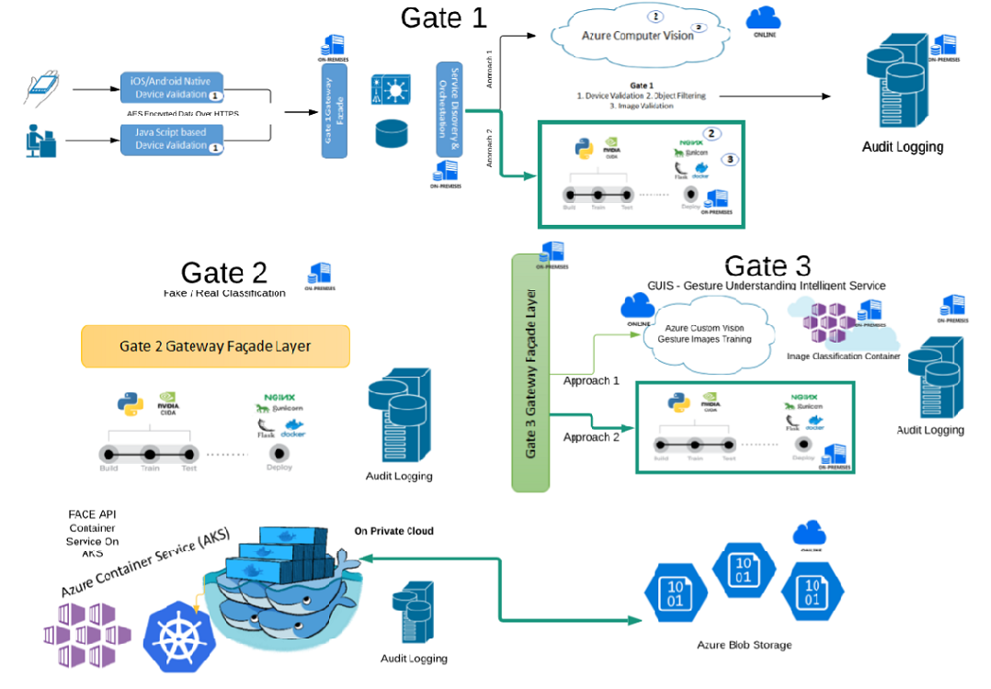

Slide 28
Services Industry vertical-wise
FMCG
bfsi
manufacturing
BFSI
Non profit (NGOs)
Govt related

Slide 29

Architectural blueprint
Solution approach
Non profits
We have build a Cognitive Data Pipeline that automates all the work of consultant with a very minimal manual intervention with the following building blocks
Data Ingestion
Bing New API
Moderation of Keywords / Content Extraction using a Custom UI
Data Storage
Storage of website Content from Bing API results in Azure Cosmos DB – Document DB Engine
Storage of Keywords, Sentiments and Recommendations on Azure SQL Server
Preparation & Training
Azure Function for Text Extraction and Sentiments Extraction using Cognitive Services API
Fetching Entity details like Place, Person and other critical information for Model Training Purpose
Azure ML Model to generate recommended actions as per the sentiments and Keywords
Reports Generation
Azure SQL DB and Azure Analytics Services to build Cubes required for Power BI Report
Data Visualization using Power BI Report with filtering & search options
Problem Statement
Consultants at Amnesty spend a lot of time on the net to collect relevant information using the keywords and extract sentiments from the content. Once content & sentiments are computed, they need to put together a report of Keywords, Location, Content, sentiment and possible action items and submit to their managers
Typically a team of 3-5 consultants spend minimum of 3 weeks fo time to generate a report for a set of 8-10 keywords. Amnesty hired JumpStartNinja to automate the whole process of content search, text & sentiment extraction and preparing good visual reports
Business impact
End to End automation of Data Search, Ingestion, Moderation, Sentiment Extraction, ML based Data Curation and Reporting
Reduced TTM (Time to Market) : Reduced almost 50 % of time required by consultants – Keywords to Power BI Report
Increased Accuracy Levels in Reports : Sentiment Extraction and Recommendations from Past History is at 90 % levels of accuracy

Slide 31
Services Industry vertical-wise
FMCG
bfsi
manufacturing
BFSI
Non profit (NGOs)
Govt related

Slide 32

Govt related
Problem Statement
Business impact
Ibvi is as an organization having a policy of employing staff who are either blind or visually in paired. They are very well training in using a lot of computer applications for performing their day-to-day operations like “Clock In”. Clock Out”, “Productivity Reporting”, Sales Order , Purchase Order Creation etc.
Though staff is well trained, it takes a lot of effort for supervisors who monitors their day to day interaction with computer applications. ibvi hired JSN to come up with some innovative solutions to emppwer their blind staff to do more using voice commands
Staff of ibvi able to do their day to day activities more efficiently by talking to the applications
Workload on supervisors drastically reduced as they do not need to monitor staff while working with applications
Solution approach
JumpStartNinja has been very instrumental with the vision of ibvi in empowering their blind staff to achieve more. We have built a layer on top of the applications that you use with eyes and ears using computer vision and Speech Services. The following Azure Components are using to build our “Eyes” “Ears” layers
Language Understanding Intelligent Service – NLP Layer of Azure
Speech to Text , Text to Speech Services
Azure Custom Acoustics Model
Web Browser Extensions that can integrate the above AI components with applications

